Slide 1

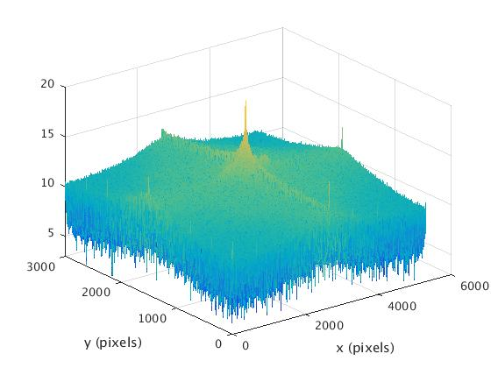
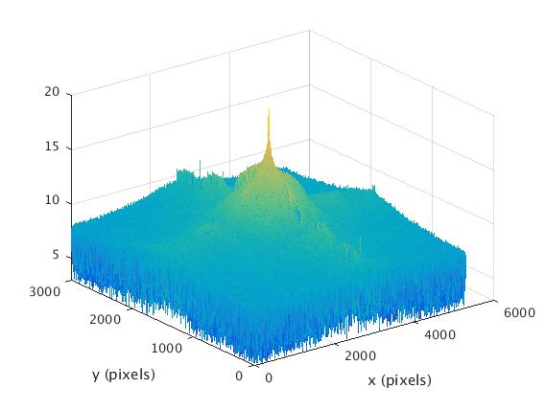
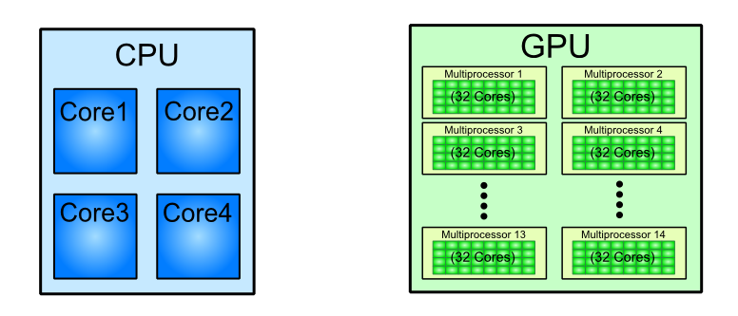
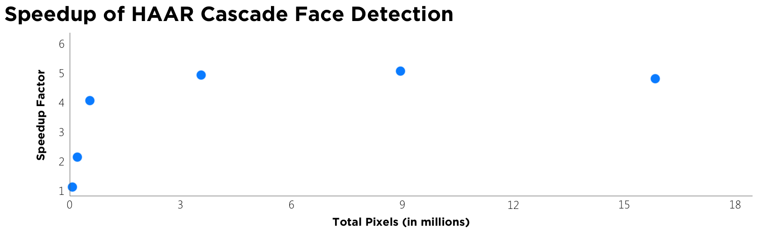
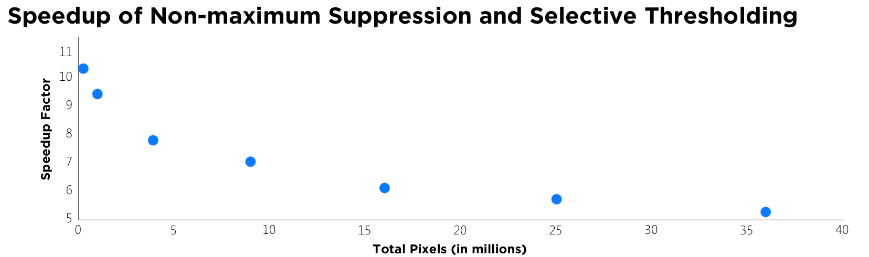
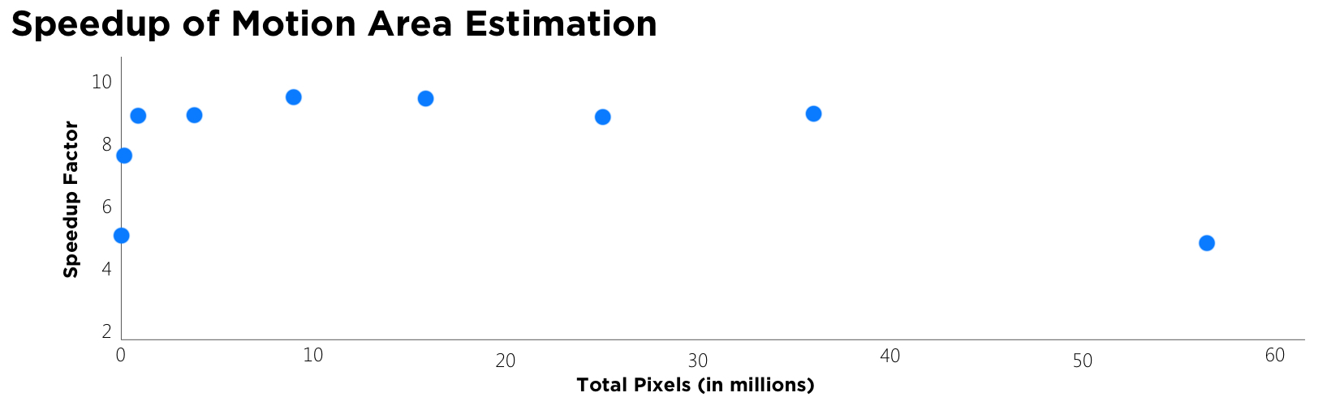
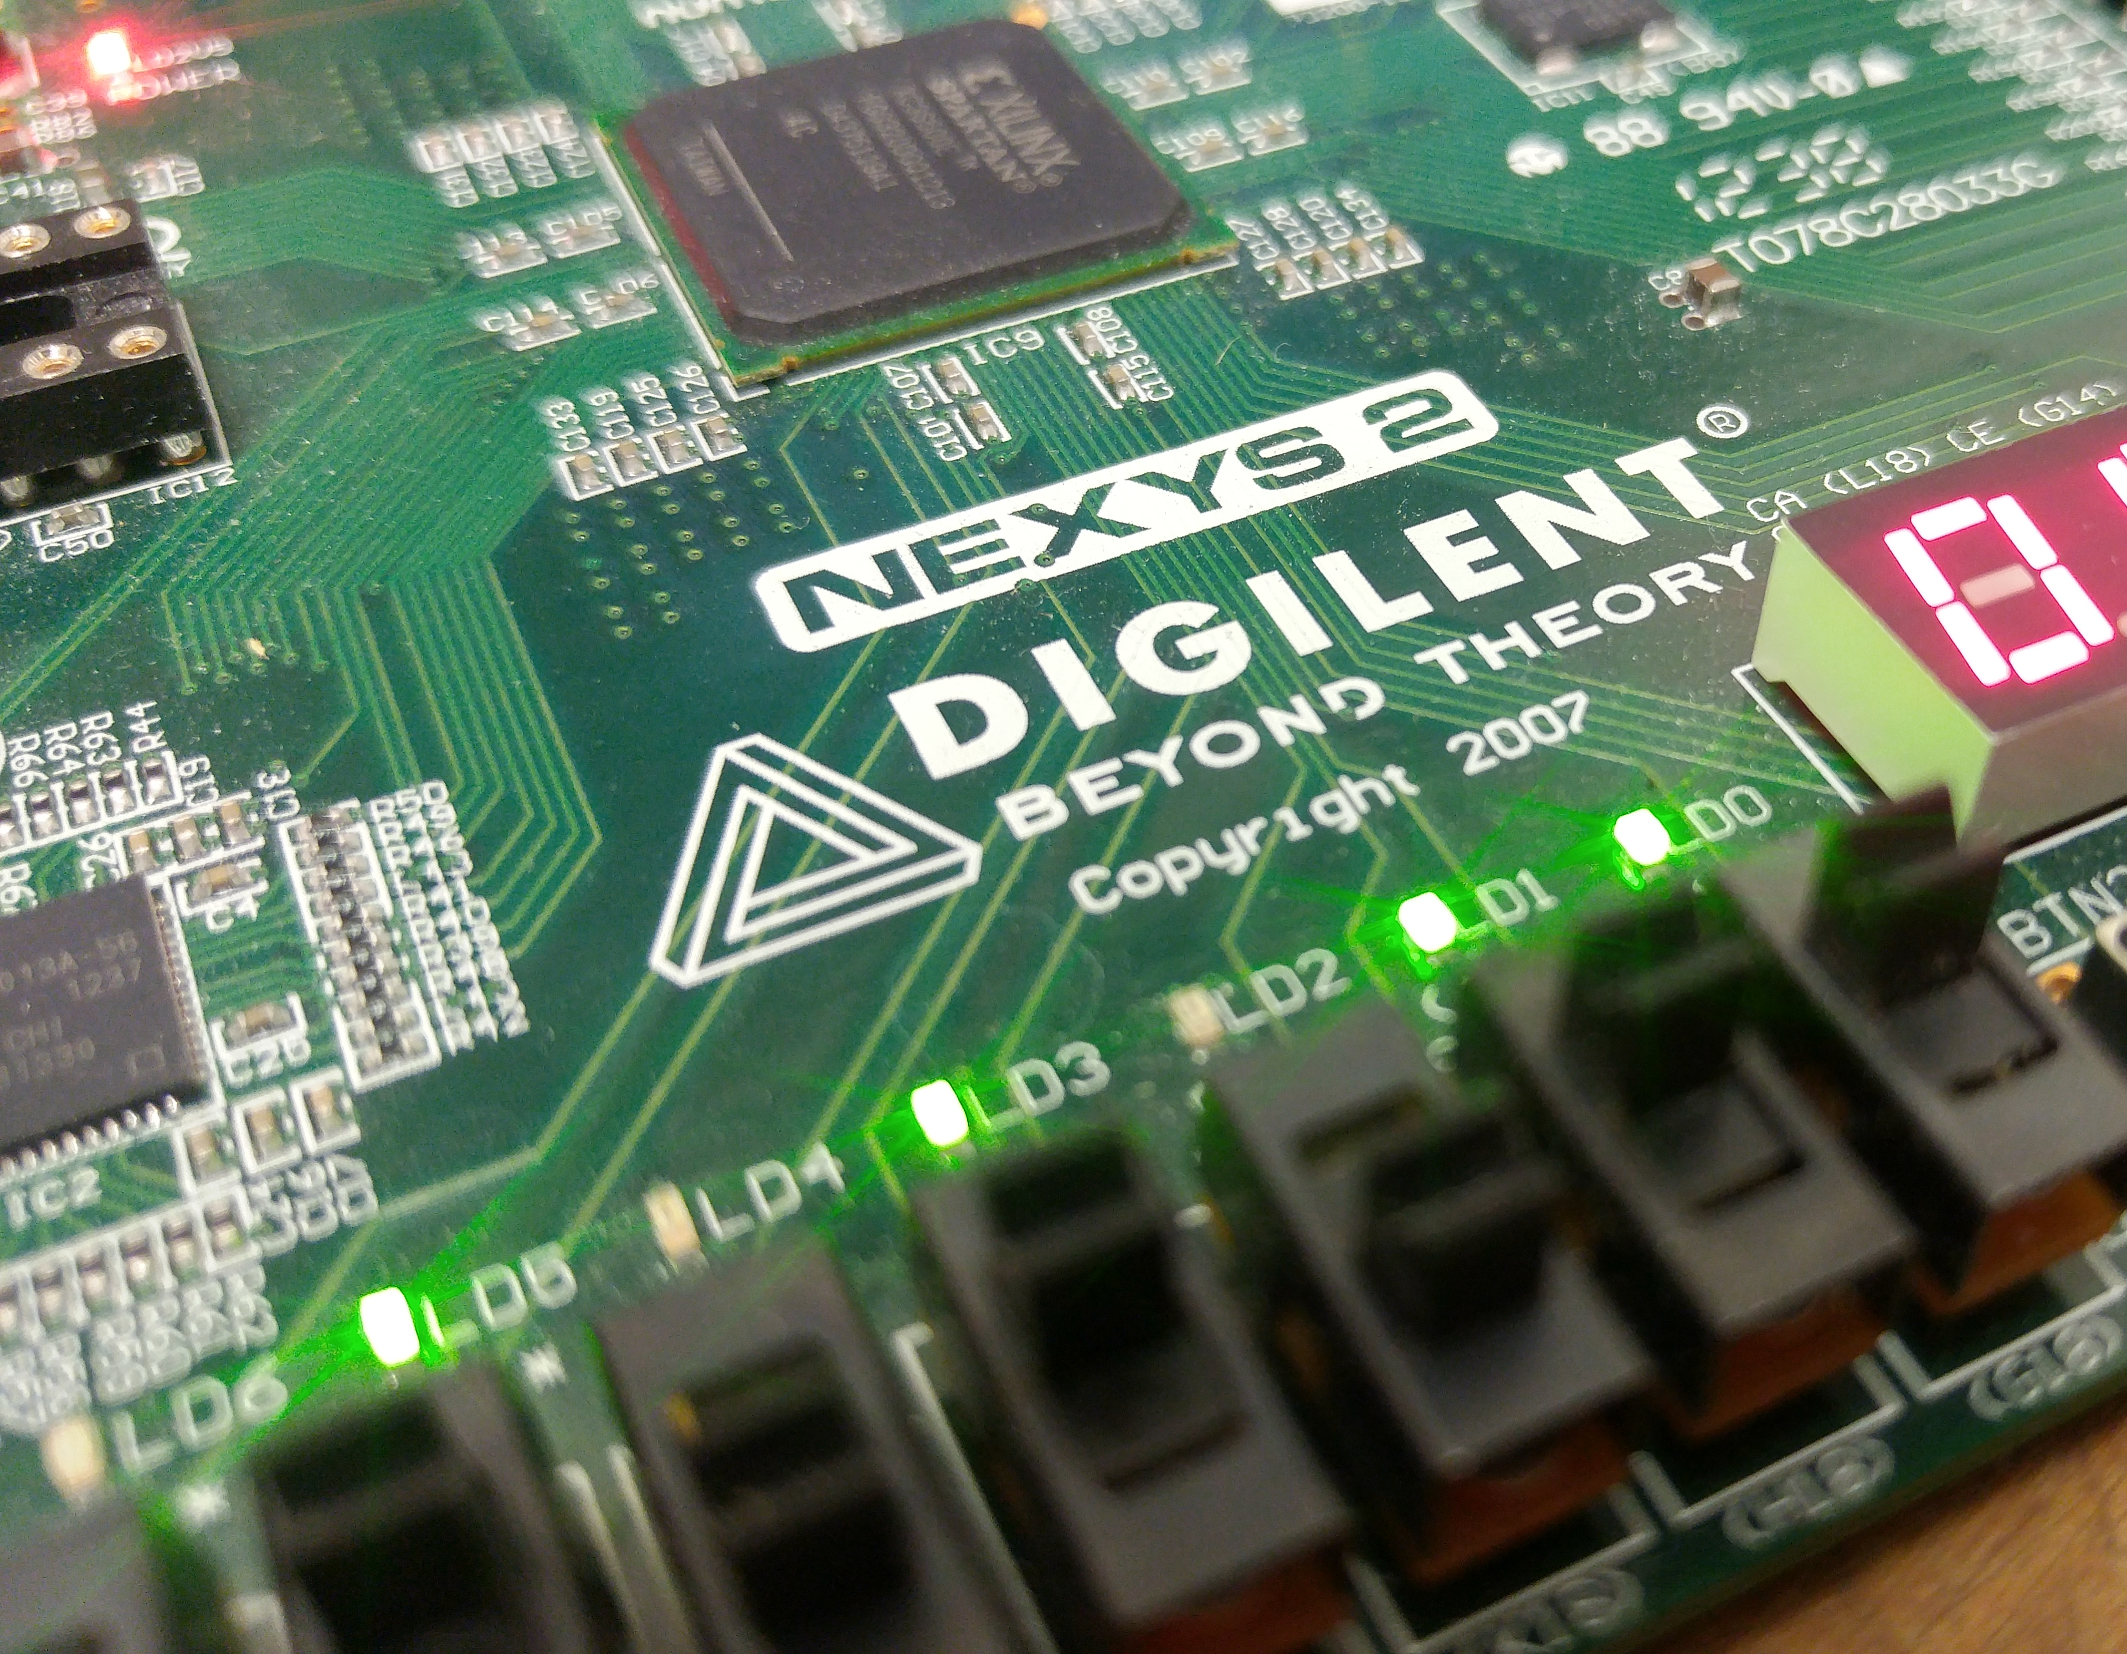
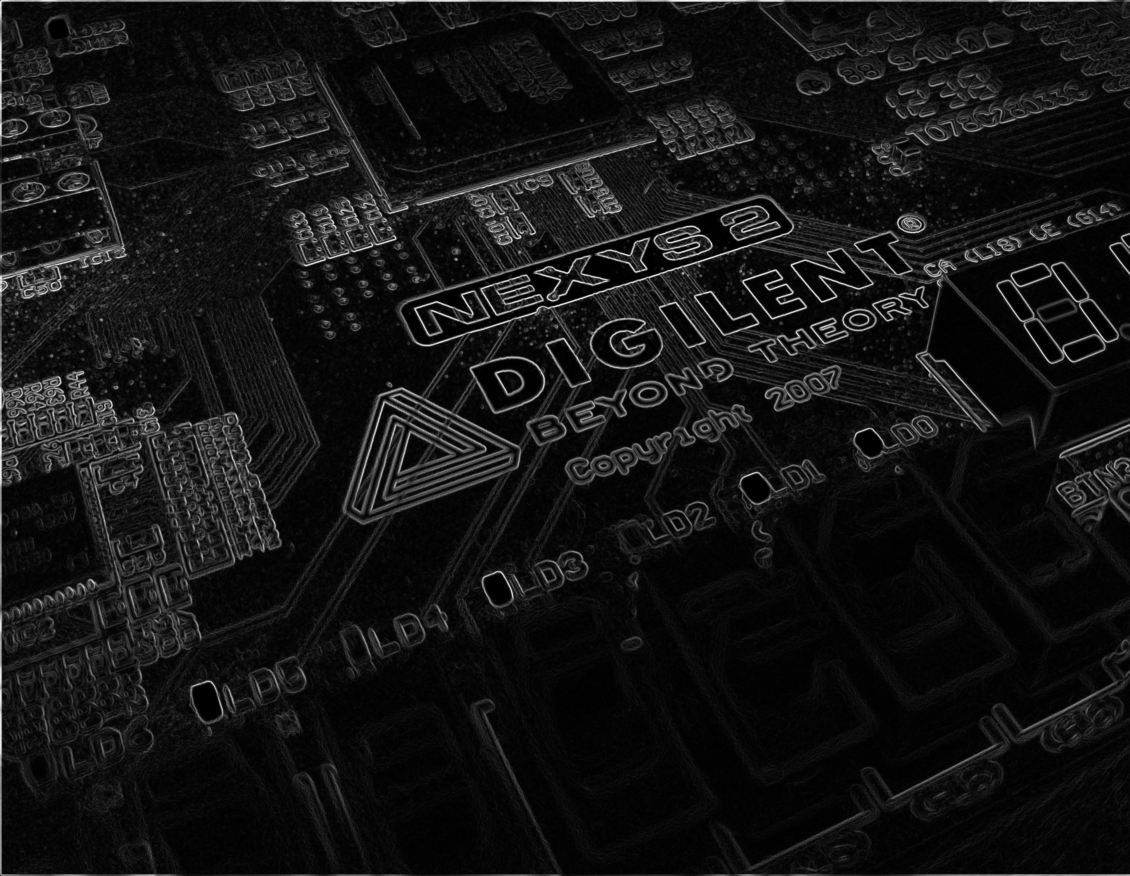
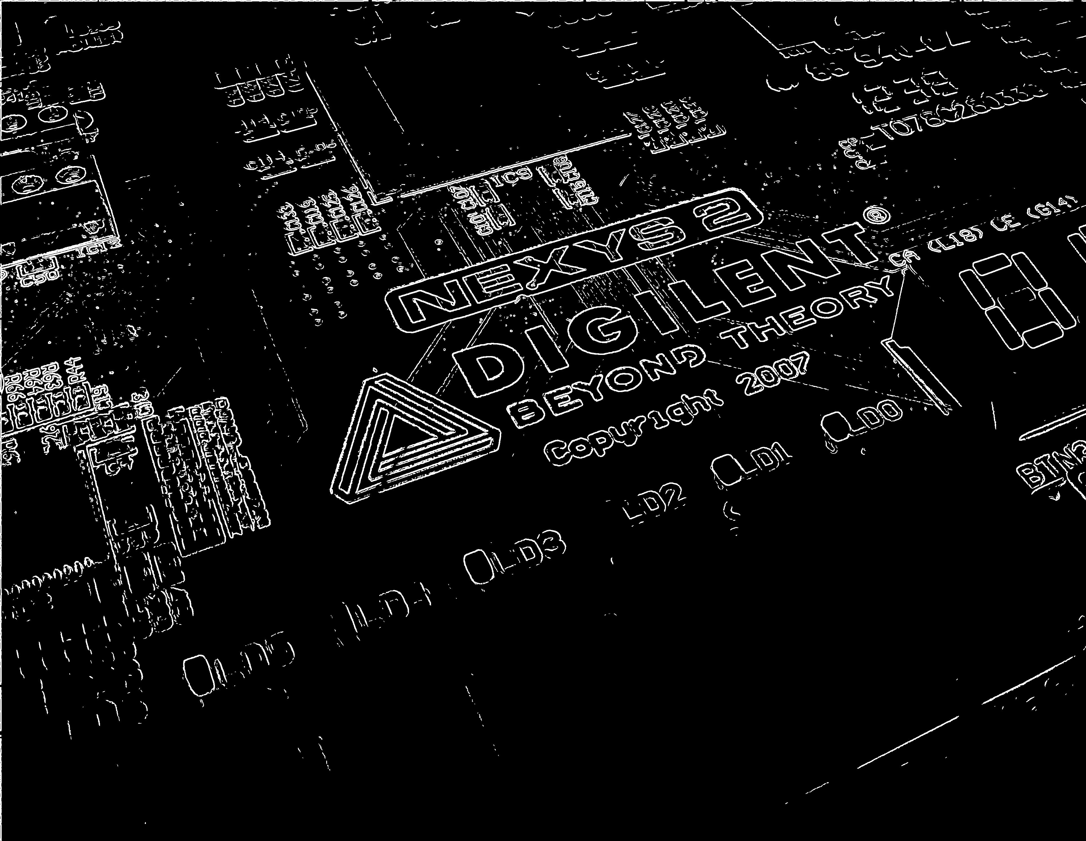
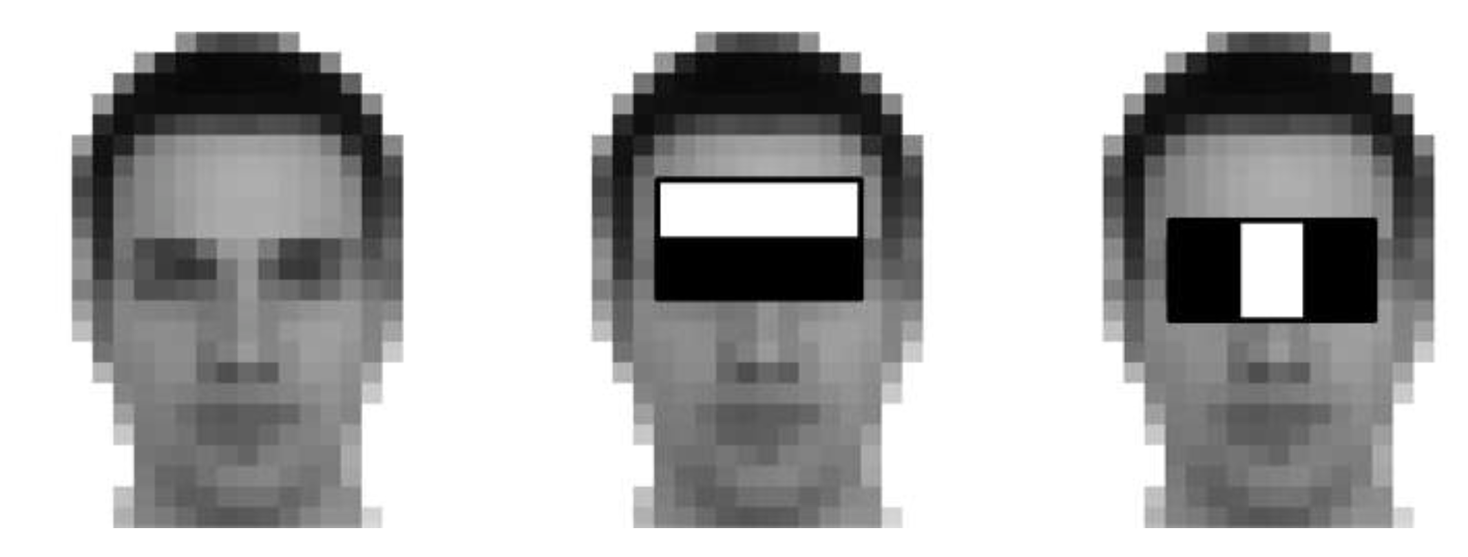
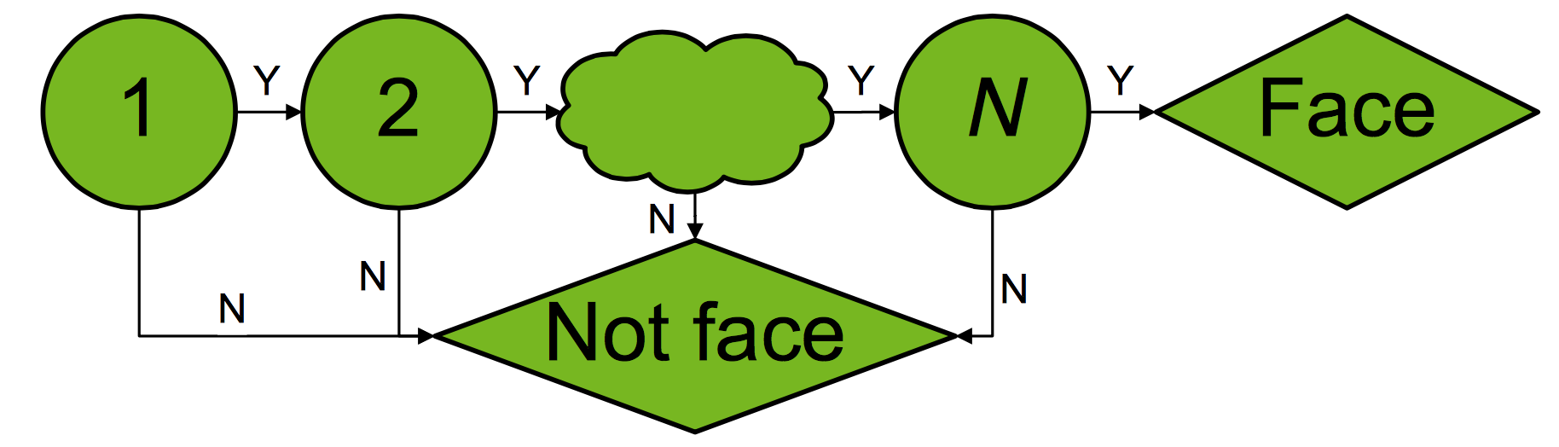
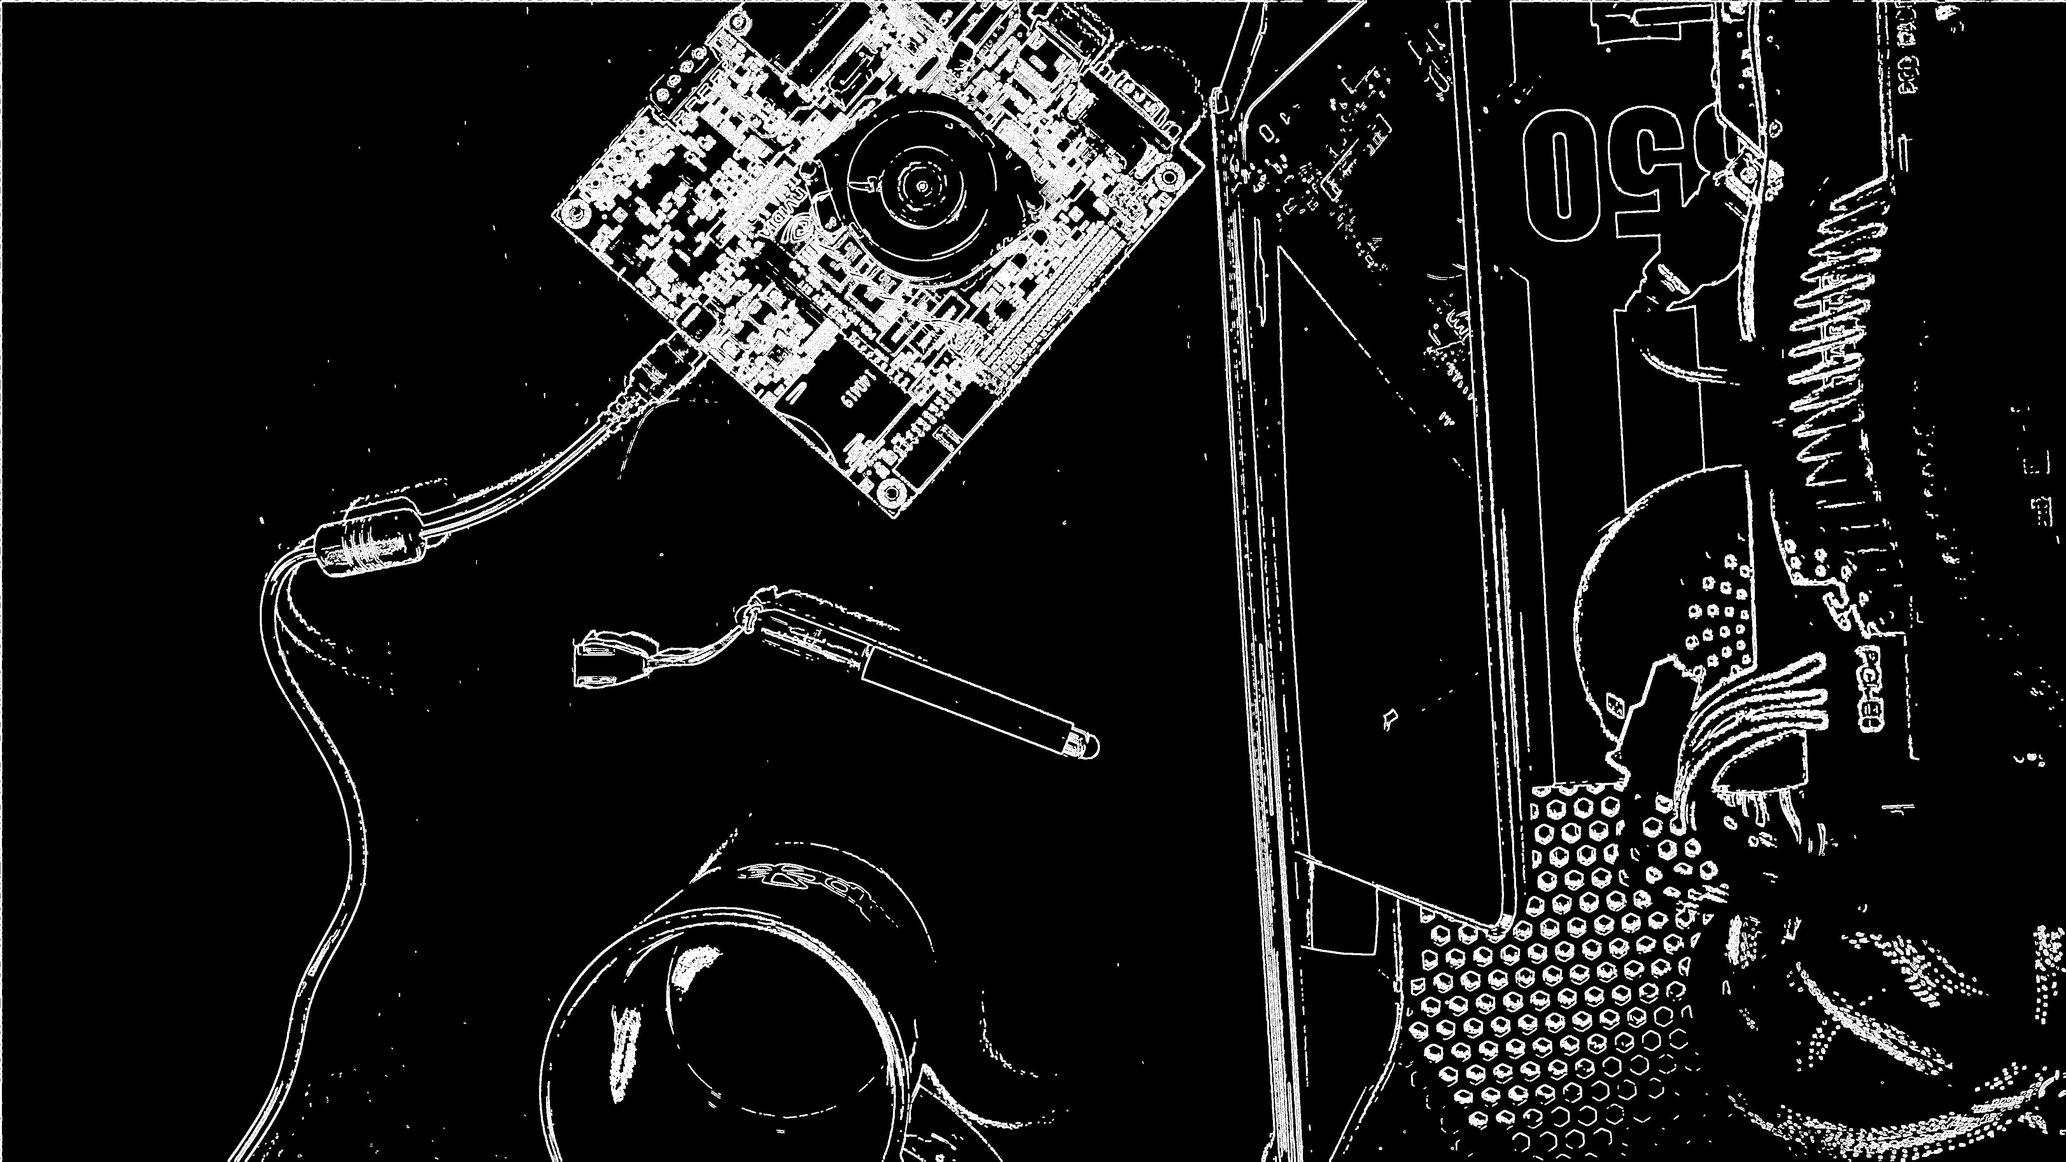

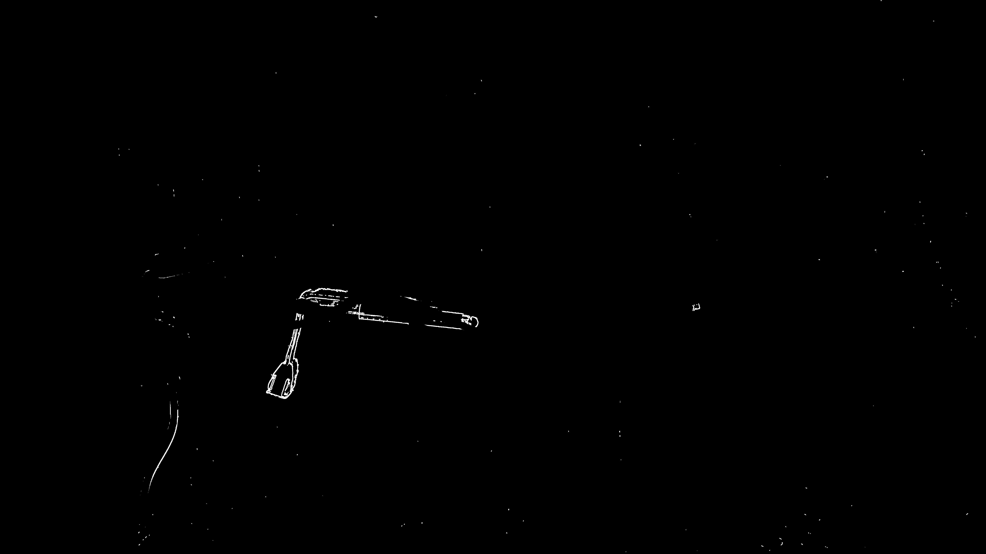
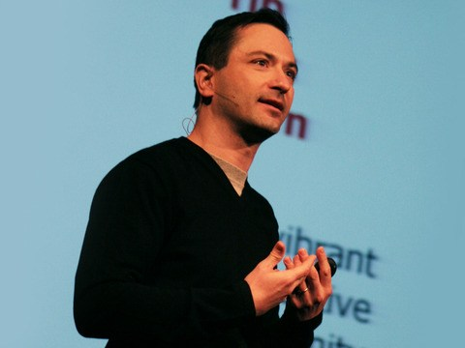
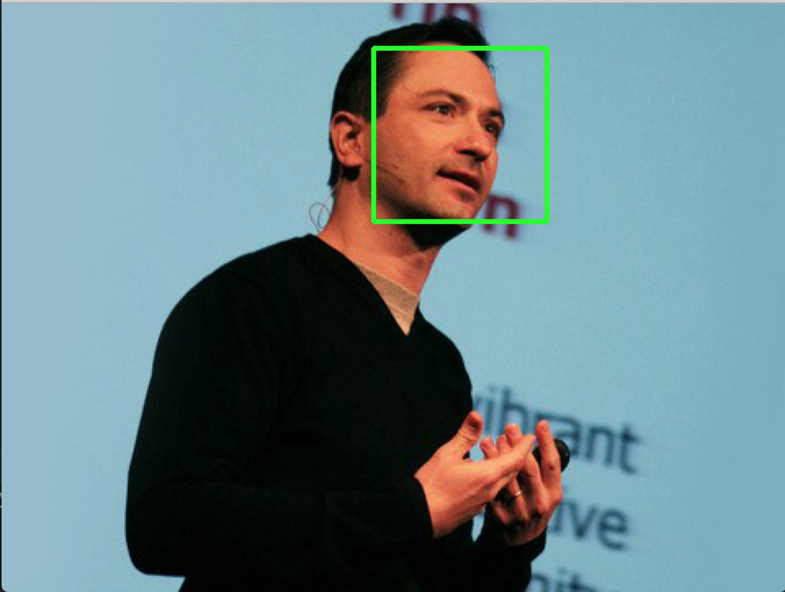
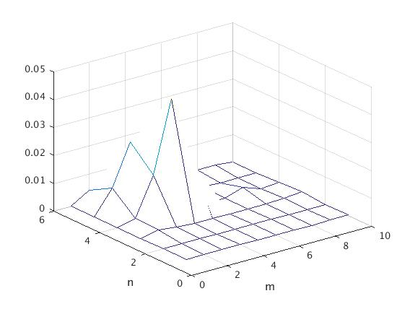

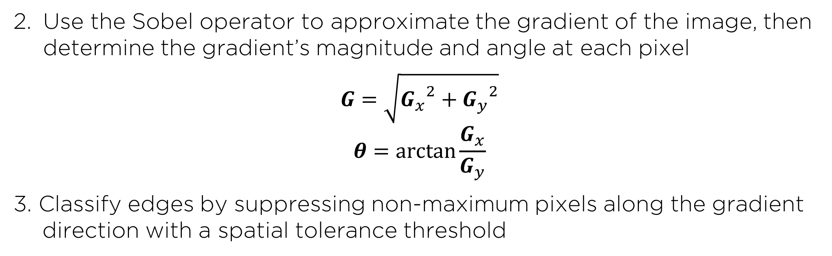
GPU-Accelerated Parallelization of
Common Computer Vision Applications
Emilio Del Vecchio, Kevin Lin, Senthil S. Natarajan
Department of Electrical and Computer Engineering, Rice University
I. INTRODUCTION
III. EDGE DETECTION
V. GPU SPEEDUP RESULTS
-Graphics Processing Units (GPU’s) have recently become popular for their ability to parallelize computations and achieve much greater efficiency as compared to the serial implementation of a CPU.
Reduce high frequency noise from the image with a Gaussian blur
-The NVIDIA CUDA framework was used to run the parallel implementations of our algorithms.
-The results below were obtained on a Intel Core i5 4200U CPU and an NVIDIA GeForce GTX 860M GPU.
VS
Fig 1. The GPU’s parallel architecture allows it to parallelize massive computations.
Fig 5. FFT of grayscale noisy image, unfiltered (left) versus filtered (right)
Use the Sobel operator to approximate the gradient of the image, then determine the gradient’s magnitude and angle at each pixel
$$G=\sqrt{{G_{x}}^{2}+{G_{y}}^{2}}$$
$$θ=\arctan{\frac{G_{x}}{G_{y}}}$$
3. Classify edges by suppressing non-maximum pixels along the gradient direction with a spatial tolerance threshold
-Our objective: utilize the GPU’s ability to accelerate computer vision applications like facial recognition, edge detection, and motion tracking.
-Due to the proliferation of computer vision in many regular tasks, this affords us an opportunity to explore how to make such common algorithms more efficient.
II. FACIAL RECOGNITION
Extract HAAR features of a face from a set of positive and negative training images.
Fig 9. CUDA facial recognition (top) consistently achieved 1.1 to 5.1x speedup. CUDA edge detection (middle) achieved 5.2 – 10.3x speedup. CUDA motion tracking tracking (bottom) achieved 4.2– 9.5x speedup.
Fig 6. Original image (left), Sobel filter output (center), final edges (right)
VI. CONCLUSIONS
Fig 2. Example HAAR features of a random face
IV. MOTION DETECTION
2. Use Adaptive Boosting machine learning to train a multi-stage, or cascade, classifier, against positive and negative HAAR features.
Calculate a pixel-by-pixel difference map from the edges of two frames, applying movement tolerance thresholding in the process
-In edge detection, as the computation size becomes larger, the speedup decreases, an unexpected trend. However this could be due to the memory overhead of running multiple parallel tasks in sequence.
-Overall, the results demonstrated that GPUs offer a powerful solution to the rising data requirements of modern computational and signal processing problems.
Despite any trends or outliers, the GPU implementations consistently were faster than the CPU counterparts.
-Potential limitations include: CUDA memory optimization and usage of 3rd party libraries (especially with facial recognition).
Fig 3. Cascade Classifier training rejects most non-face regions early.
Fig 7. Two sequential frames in a video stream and the detected difference between them
3. Apply final cascade classifier to a loaded image. The OpenCV library provides modules to encapsulate this process.
Estimate the motion region from a difference density map
VII. ACKNOWLEDGEMENTS
Fig 4. Original sample image (left), detected faces (right)
Fig 8. Spatial density map (left), motion area estimation (right)
-We would like to thank CJ Barberan and Richard Baraniuk for their guidance and support in this project.

